Slide 1

Unpacking the Mystery Behind a Box Office Success
Navina Govindaraj
Notes:
Good morning everyone. I’m sure most of us enjoy watching movies. We’ve seen movies that were set to be box office money makers turn out to be duds and vice versa. So the question remains,

Slide 2
Problem Statement
Can we predict the box office gross for a movie?

Slide 3
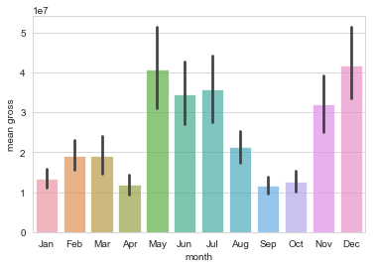
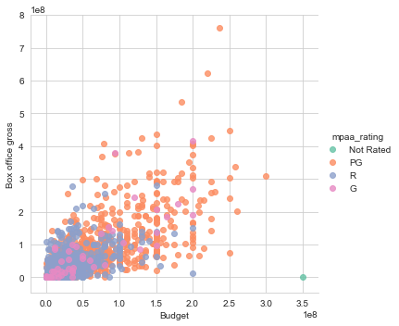
Feature Selection
Runtime
Budget
Total number of user votes
User/IMDB Rating
Critic Rating
Genre
MPAA Rating
Release Month
Notes:
To do this, I looked at the IMDB website and scraped the features that you see on screen and performed analysis on over 2000 movies. In terms of analyzing the data, let’s look at some interesting trends. The first graph shows us that the blockbusters peak during the May - July time frame and there’s yet another peak during the holiday season towards the end of the year. Notice how in the second graph you see a lot of R and G rated movies towards the lower end of the budget and gross spectrum whereas you see a lot of orange circles showing PG rated movies towards the higher end. We will see in the coming slides if these features made it to our final model or not.

Slide 4
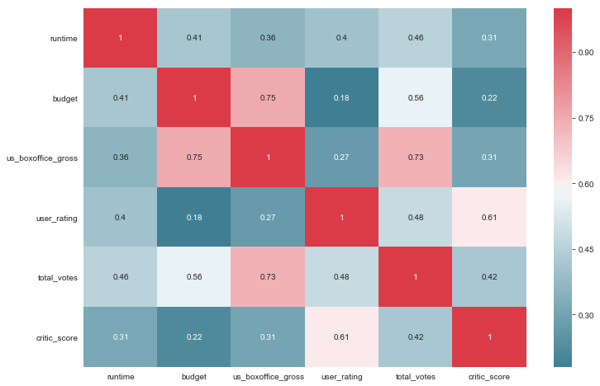
Correlation Matrix
Notes:
Here we have a correlation matrix of all of our numeric variables. Everything in pink here, shows high correlation with box office gross whereas everything in blue indicates low correlation. It is evident from that budget has the highest correlation with box office gross followed by the total number of votes posted for each movie on IMDB. Critic score, user rating and runtime show low correlation.

Slide 5

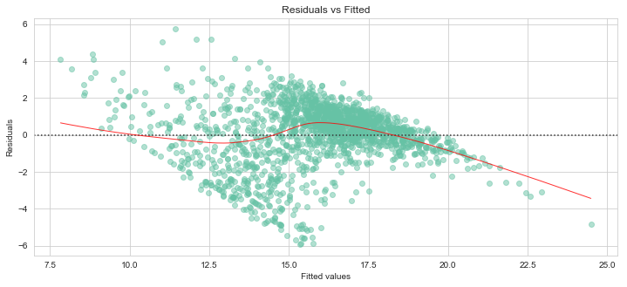
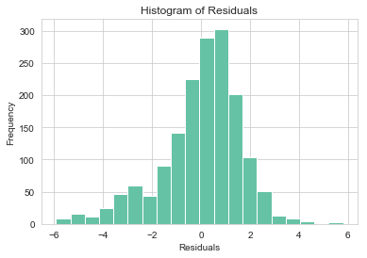
Linear Regression Model
Notes:
Coming to the machine learning models that were used to try and predict the box office numbers, I began with a linear regression model. After repeated trials with several feature engineering and feature elimination techniques, it was clear that my model did not satisfy the assumptions of linear regression. Here you can see that though the residuals show a normal distribution centered at around 0, the residual vs fitted plot shows a high degree of heteroskedasticity, which means that variance is not uniformly spread across residuals, due to which this model is not reliable. This led me into trying a random forest regression.

Slide 6
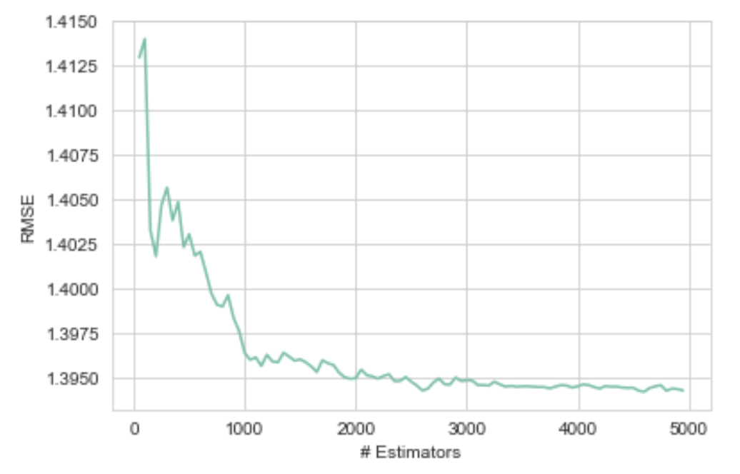
Random Forest Regression
Random Forest
Notes:
For the Random Forest model, I picked the most optimum hyperparameters by using a grid search. At around 1000 estimators/1000 trees, the error starts plateauing.
Though model interpretation in terms of dollars is difficult in this case, random forest gives us the list of features used by a specific model based on the order of importance.

Slide 7
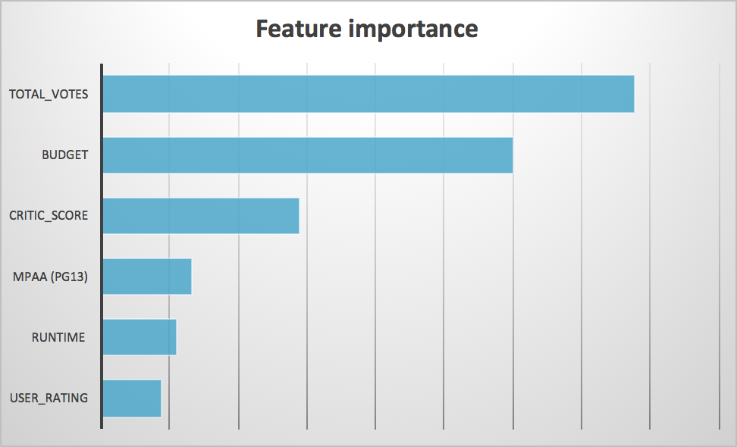
Final Model: Random Forest
Preliminary Model
Final Model
28 features
15 layers
5 to 5000 trees
6 features
3 layers
1000 trees
Notes:
I started out with quite an expansive tree with around 15 layers when the modeling process began
After hyperparameter tuning and several iterations later, the tree was pruned to 3 layers.
Here are the features that made it to the final model. Now before I started this project, I would have thought that user rating would play a huge role in a movie being high grossing. But apparently not. The rationale is that more than whether the audience enjoyed the movie or not, it matters how curious they were to go and watch the movie. The total number of votes tops the list of features followed by budget. ALso note that PG rated movies have also made it to the list.

Slide 8


In Conclusion...
Notes:
This analysis hasn’t included key features such as director, and movie stars. Those would be worth exploring as well.
The next movie that hits the theatre could be a star-free blockbuster like minions or a star filled dud like Duplicity. Hopefully ML models like these help us gain deeper insight into that magic combination which makes a movie tick.

Slide 9
Thank You!

